Slide 1
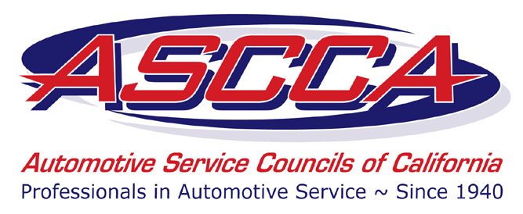
www.ascca.com
Your Future In the Automotive Industry

Slide 2
Automotive Career Mythbusters
The automotive industry has evolved dramatically in the last two decades, and it will keep changing.
However, persistent myths make it a little difficult to figure out just what a career in the automotive industry can be.
www.ascca.com

Slide 3
Automotive Career Mythbusters
Fortunately, by knowing a little more about what’s fact and what’s fiction, you’ll be able to make an informed decision about which career path is best for you.
Here are some of the most common misconceptions about careers in the automotive industry, and the facts that clear them up.
www.ascca.com

Slide 4
AUTOMOTIVE WORK IS DIRTY
With the advanced technology in cars today, electronic diagnostic equipment is as much a part of the industry as a wrench.
Some jobs in the field will always be hands-on (which is great for many folks who love it), but there are many positions that don’t depend on having a mechanical nature or a love for grime.
www.ascca.com

Slide 5
AUTOMOTIVE WORK IS DIRTY
As we will discuss later, great careers exist in the automotive industry like finance manager, salesperson, or automobile designer.
Having a great career in automotive is based on your passion for learning how to repair and service cars or working with others to solve the needs of customers—not your gender.
www.ascca.com

Slide 6
THE AUTOMOTIVE INDUSTRY IS JUST FOR MEN
The opportunity for women is just as abundant in this industry as it is for men.
In fact, women tend to possess better communication skills that help build trust and relationships with customers, allowing them to succeed in any role within the profession.
We are actively recruiting talented young women and men into this amazing industry.
www.ascca.com

Slide 7
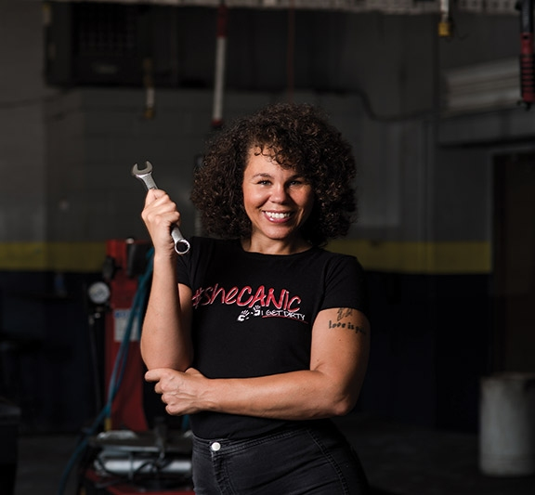
THE AUTOMOTIVE INDUSTRY IS JUST FOR MEN
Here are just three examples of women making a large and positive impact on the automotive industry.
Patricia Banks
Jumpstart Auto Repair
Mary Barra
Patricia Banks is an automotive technician and founder of Girls Auto Clinic, an auto care business, consultancy and workshop that caters to women. She is also the author of the GAC Glove Box Guide.
Jumpstart Auto Repair is an all-female-run auto repair shop that helps domestic violence survivors who may not be able to afford essential car repairs.
As acting Chief Executive Officer of General Motors, Mary Barra has placed herself in the history books as the first female CEO of a major global automaker.
www.ascca.com

Slide 8
AN AUTO TECH ONLY NEEDS MECHANICAL APTITUDE
Of course, it’s essential for techs to have mechanical abilities. But with the ever-expanding technology in vehicles, auto techs also need to be computer savvy and enjoy learning about new features and materials.
Every model includes new options and technology that didn’t even exist a few years ago.
www.ascca.com

Slide 9
AN AUTO TECH ONLY NEEDS MECHANICAL APTITUDE
Of course, it’s essential for techs to have mechanical abilities. But with the ever-expanding technology in vehicles, auto techs also need to be computer savvy and enjoy learning about new features and materials.
Every model includes new options and technology that didn’t even exist a few years ago.
www.ascca.com

Slide 10
AUTO PROFESSIONALS DON’T MAKE COMPETITIVE SALARIES.
A career in the automotive industry can be a lucrative position with continued education and experience.
The salary for entry-level auto techs typically starts around $60,000 per year, but it can quickly grow to more than $100,000 per year for senior techs.
In addition, most auto careers offer great benefits, comfortable working environments and access to continued training and education.
www.ascca.com

Slide 11
YOU NEED TO GO TO A FOUR-YEAR COLLEGE TO BE SUCCESSFUL.
Many employers look for automotive mechanics or technicians who possess a certificate, diploma, or associate degree from an accredited school. After graduating from an automotive program in only two years, you can earn money and gain real-world experience while your friends are still in school.
Plus, qualified professionals are in high demand, which means there’s likely an open position waiting for you right now!
www.ascca.com

Slide 12
Why Choose a Career in the Automotive Industry
01
FUEL YOUR FUTURE WITH A JOB THAT FITS YOU
BECOME A PART OF THE REVOLUTION
02
Behind a desk or under the hood—it’s your call. There are service, repair and corporate careers that ALL have openings right now.
Motorheads are welcome…and so are techies. Electronic diagnostic equipment is as much a part of the industry as a wrench. Technology in cars is changing at a fast pace every year to include new advances in fuel economy, body materials and infotainment features.
03
CAR CAREERS ARE HOT!
MAKE MONEY NOW AND DOWN THE ROAD
04
The auto industry employs 4.6 million people in the U.S. and needs even more to support the high-tech cars of today. From 2016-2026 the industry will need an average of 75,900 new auto technicians and 17,200 new collision repair technicians each year.
These are not dead-end jobs. Auto professionals earn competitive salaries, with many entry-levels jobs over $35K. And you can make more than $60,000 per year after gaining some real-world experience. Superstars can make six figures.
05
GET TO YOUR FUTURE – FAST
CHART YOUR OWN COURSE!
06
Go from just thinking about it to working and getting paid in only two years! Two-year college programs offer hands-on educational training that will prepare you for the hands-on work you’ll do in your career.
An automotive career hands you the keys to your future. A career in the auto industry provides stable, long-term employment that allows you to work anywhere in the country or throughout the world.
www.ascca.com

Slide 13
Different Careers in the Automotive Industry
As you can see, there are many different reasons to enter the automotive industry. Most importantly, there are a wide range of jobs available to people of many different interests, so you should be able to find something you like (even if you’re not all that interested in cars).
In this field, with the right training, you can advance to higher positions relatively easily. Here is a look at different career opportunities that await you in the automotive industry.
www.ascca.com

Slide 14
Different Careers in the Automotive Industry
Automotive Technicians
Automotive Mechanic
Diesel Mechanic
Auto technicians are trained to be able to interact with the computers in your car in order to diagnose its problems. The job responsibilities of an automotive technician includes diagnosing car problems, engine repair, heating and air conditioning repair, etc. To become an automotive technician, you must become trained and certified.
Mechanics are responsible for performing many of the same tasks as technicians. Unlike technicians, auto mechanics are more equipped to handle the mechanical aspects of repair. These tasks include things such as replacing engines, alternators, or fixing suspension and mechanical problems. In order to become a mechanic, you will also need more education and experience.
Becoming a diesel mechanic is also a great option in automotive industry. These guys are responsible for repairing and servicing diesel engines. Although this includes a few passenger vehicles, diesel mechanics have most of their focus on buses and trucks.
www.ascca.com

Slide 15
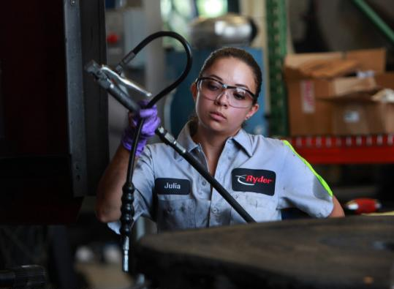
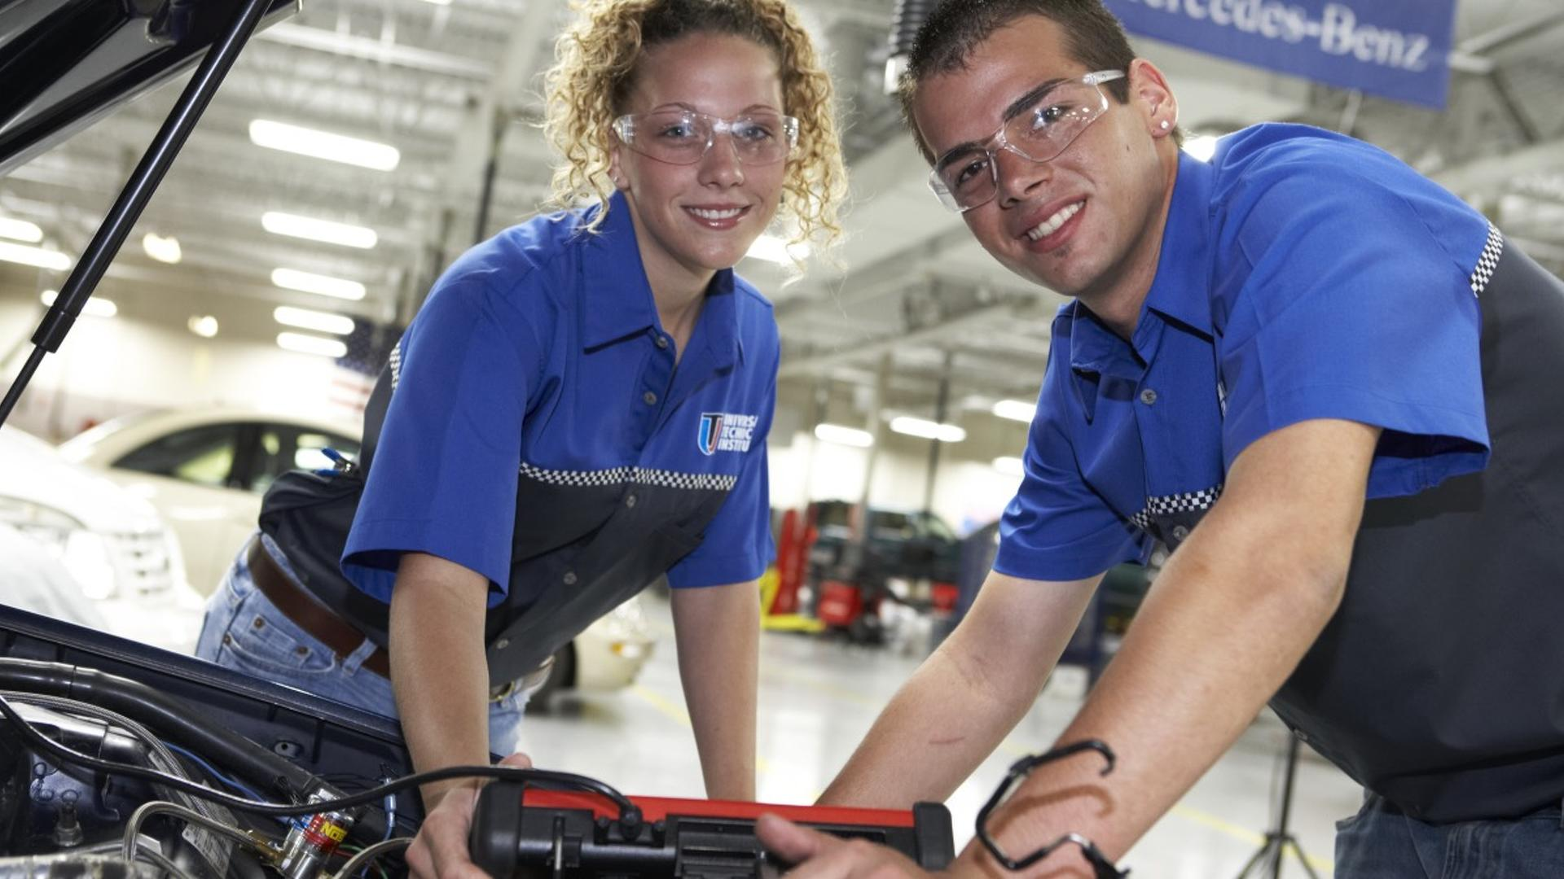
Different Careers in the Automotive Industry
www.ascca.com

Slide 16
Different Careers in the Automotive Industry
Car Salesperson
Internet Sales Manager
Finance
If you enjoy communicating with people rather than fixing cars, becoming a car salesperson may be the perfect career with you. You would spend the majority if your day trying to sell cars to people who visited the car lot. Your salary would be based on the amount of commissions you earn. You can also work your way up the ladder into a management position as you gain experience.
Similar to a floor salesperson, an internet sales manager works with leads received from the internet. Some of these leads come in direct due to the dealer’s website advertising, others come in from affiliated websites who work with you to sell cars. This is one of the best paying and most sought-after positions in auto sales. The top-producing and most quick-witted sales staff advance to this position.
More of a money person? Finance and insurance department of a car dealership are a good opportunity. People looking to buy a new car will need financing and insurance in order to get it. You would have to work with sales staff, management and lenders (and of course the customer) to do your job. After you gain experience in this department, you can achieve a higher role in the dealership (i.e., Finance manager).
www.ascca.com

Slide 17
Different Careers in the Automotive Industry
www.ascca.com

Slide 18
Different Careers in the Automotive Industry
Body/Paint Specialist
Assembly Line
Automobile Design
A career opportunity in the automotive industry that is expanding is a body and paint specialist. As one of these specialists, you would have to repair damage that resulted from a car accident of some kind. You would have to fix the exterior of the car and then restore the paint job as well. Thanks to the fact there are plenty of car accidents around the country, this position is in high-demand.
Another option is to get a job on the assembly line. Getting your foot in is not easy, but it’s easier than before. You could join an assembly line that focuses on making cars, or even a line that simply makes certain parts that go in the cars. Nowadays, most assembly line positions require some knowledge about computers and robotic manufacturing.
If you’re an artistic person, another option is automobile design. As its name suggests, you would be tasked with coming up for new car designs. This career is in high demand thanks to the fact trends are constantly changing in the car industry. However, you will need plenty of education in order to begin a career as a designer, and your first employment and first projects won’t be designing cars.
www.ascca.com

Slide 19
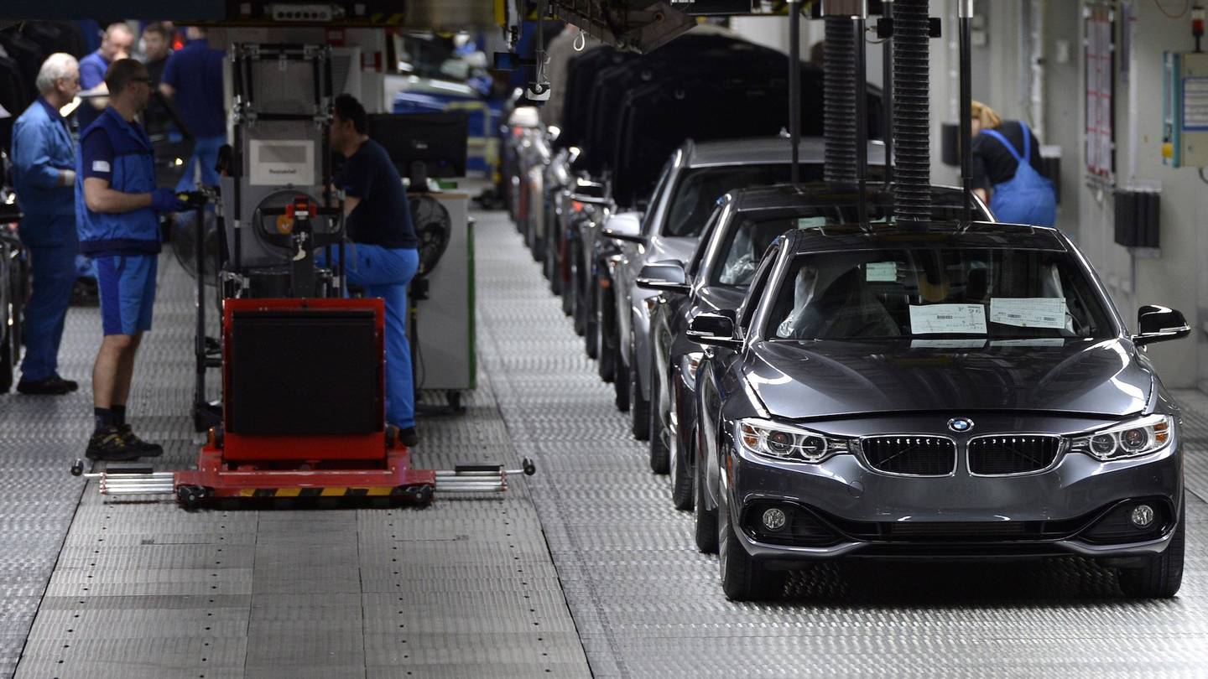
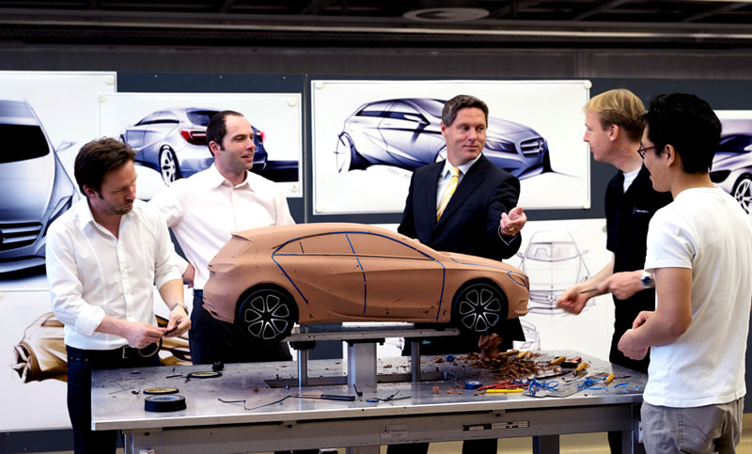
Different Careers in the Automotive Industry
www.ascca.com

Slide 20
Different Careers in the Automotive Industry
While there are a wide variety of jobs in the industry, it takes the right attitude and experience to succeed in the automotive world. Alongside the technical and practical skills, you will learn along the way, you will also need to:
Be Passionate When it comes down to it, being passionate about the industry will help you to become successful. Passion drives talent and enables you to stand out, opening new doors and improving your job satisfaction.
Problem-Solve Any job in the auto industry will require you to solve problems through research, development and manufacturing. At every stage of the cycle, spotting a problem and minimizing the risk or damage is a key challenge.
Communicate A huge part of the automotive industry is based on service. Whether you have ambitions to open a small business or work within a global company, you will need to relate well to people. This means translating industry jargon into easy terms, understanding the brief and maintaining great lines of communication with your team members.
www.ascca.com

